Slide 1
IT3081 Statistical Modelling
Airline Passenger Satisfaction: Drivers and Decision Support
Industry Innovation Consulting Challenge: From Data to Strategic Decisions
Airline Passenger Satisfaction Analysis | Commercial Aviation | Pulindu · Ayendri · Nisalma · Vidu

Slide 2
Presentation Flow
02
Presentation Roadmap
What the team will cover, from the problem to the final recommendations.
Industry problem and consultancy objectives
Dataset, analysis, modelling and evidence
Innovation proposal (decision support) and recommendations
Industry validation and viva readiness
15
minutes
12
consultancy tasks
IT3081 Statistical Modelling · Consultancy Presentation

Slide 3
Task 1
03
Industry Problem & Consultancy Objectives
A post-flight survey exists, but it is unclear which services drive satisfaction.
129,880
Commercial aviation: post-flight survey of 129,880 passengers
Problem: the airline does not know which service areas are linked to satisfaction
Stakeholders: management, customer experience, in-flight, airport operations, digital, marketing
Decisions influenced: which services to fix, which segments are weak, where to put budget.
Objectives: Find group differences.
Measure effect sizes.
Identify service drivers.
Build and compare logistic models
passengers surveyed
56.6%
neutral or dissatisfied
IT3081 Statistical Modelling · Consultancy Presentation
Notes:
R check: Steps 2-6 output (dim, table(Satisfaction)). Figures checked against the output of part111_final_steps1_22.R.

Slide 4
Task 2
04
Research Landscape & Research Gap
Prior work stresses prediction accuracy; we add interpretation and action.
Xue (2025): random forest beat logistic regression on accuracy (92% vs 85%)
Krirkchaiwan (thesis): online boarding and in-flight Wi-Fi were the most significant factors, which our model also finds
Gao et al. (2021): service effects are nonlinear, with interactions between passenger traits and services
Our gap:
many studies chase prediction accuracy and skip explainable driver analysis. They often drop missing or zero-coded ratings, which is a leakage and preprocessing weakness.
Key literature
Gao, K., Yang, Y., & Qu, X. (2021). Examining nonlinear and interaction effects of multiple determinants on airline travel satisfaction. Transportation Research Part D: Transport and Environment, 97, 102957. https://doi.org/10.1016/j.trd.2021.102957
Xue, J. (2025). Airline passenger satisfaction prediction and key influential factors identification based on logistic regression and random forest. Proceedings of IAMPA 2025, 610–614. https://doi.org/10.5220/0013834200004708
Krirkchaiwan, P. (2024). A study of airline passenger segmentation based on satisfaction evaluation using data science techniques [Master’s project, Srinakharinwirot University].
https://ir-ithesis.swu.ac.th/handle/123456789/3138
Our approach:
train-only preprocessing, N/A flags, effect sizes, model comparison and a decision tool.
IT3081 Statistical Modelling · Consultancy Presentation
Notes:
Sources found by web search and checked at abstract level only. Read the full papers before quoting numbers in the viva, and add any extra papers your team has used.

Slide 5
Task 3
05
Dataset Selection & Understanding
Public airline passenger survey, one row per passenger.
https://www.kaggle.com/datasets/sjleshrac/airlines-customer-satisfaction
129,880 passengers, 24 columns: ID, demographics, trip details, 14 service ratings, delays
Target: Satisfied (43.4%) vs Neutral/Dissatisfied (56.6%)
Quality: 0 ratings treated as N/A and flagged; 393 missing arrival delays imputed; no duplicate passengers
Missing: about 393 values (reported as 310 in train plus 83 in test in the original split)
Service ratings are actionable levers, so the data supports business decisions
Why it suits the problem: large n, a mix of rating, categorical and numeric variables, a binary target, and decisions that map directly to services.
IT3081 Statistical Modelling · Consultancy Presentation
Notes:
R check: Steps 2-6 output (data quality, missing values). Figures checked against the output of part111_final_steps1_22.R.

Slide 6
Task 3
06
Descriptive Analysis & Initial Insights
Satisfaction differs sharply by class, travel purpose and loyalty.
Passenger class
  Business : 69% satisfied
  Economy : 19% satisfied
  Gap : 50 points
Type of travel
  Business travel : 58% satisfied
  Personal travel : 10% satisfied
  Gap : 48 points
Customer type
  Returning customers : 48% satisfied
  First-time customers : 24% satisfied
  Returning customers are twice as satisfied
Departure delay
  On time : 46% satisfied
  Over 60 min : 36% satisfied
  Gap : 10 points
IT3081 Statistical Modelling · Consultancy Presentation
Notes:
R check: step19_segment_satisfaction.csv and step19_delay_effect.csv. Figures checked against the output of part111_final_steps1_22.R.

Slide 7
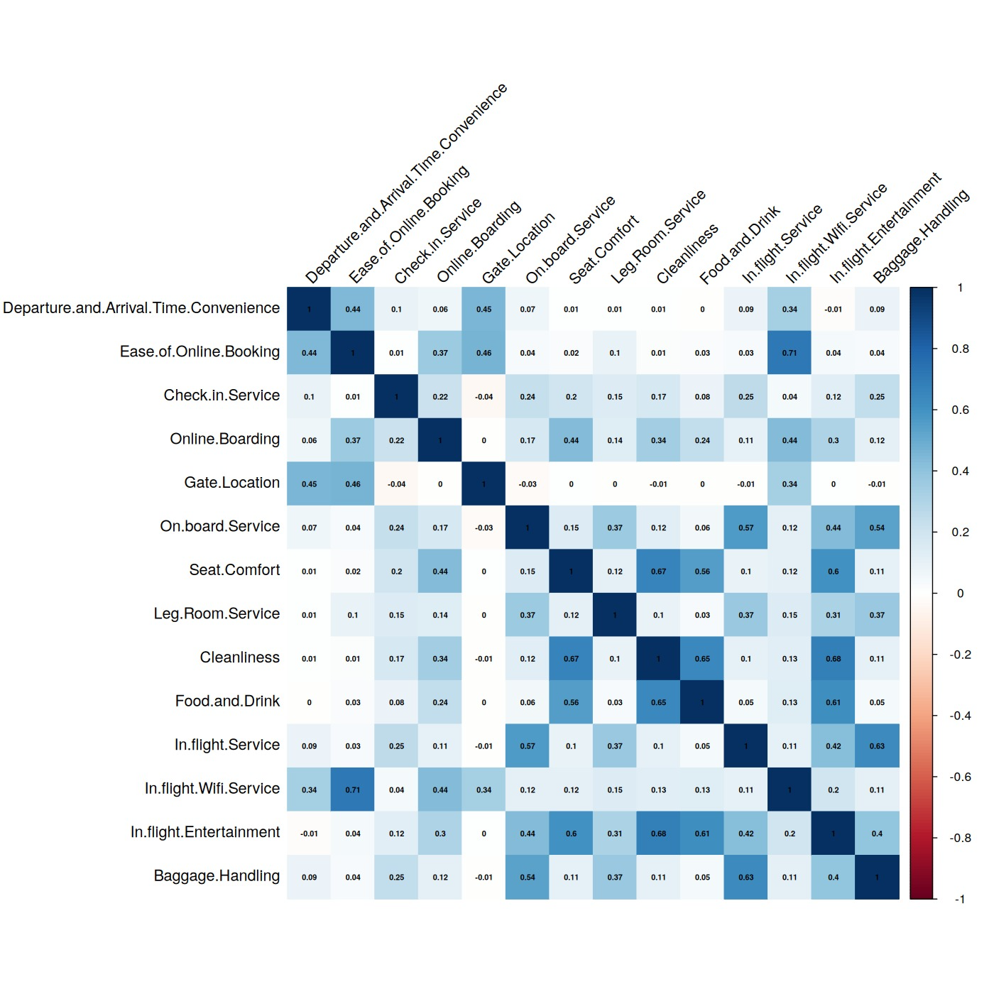
Task 4
07
Strength of association with satisfaction (Cramer's V
Statistical Inference Evidence
Chi-square, t-tests and ANOVA confirm the segment gaps (training split).
Test | Finding | Result
Chi-square | Satisfaction depends on class, travel type and loyalty | All p < 0.001
 | Gender effect | Negligible
Welch t-test: Age | Satisfied passengers are older | Age:41.7 vs 37.6 yrs, d = 0.27
Welch t-test: Departure delay | Satisfied passengers had shorter delays | Departure delay12.5 vs 16.4 min, d = -0.10
Spearman correlation | Used for ordinal service ratings and skewed numeric variables | Identified correlated service variables and relationships with satisfaction
One-way ANOVA | Service score differs by class | F = 4,420, p < 0.001
IT3081 Statistical Modelling · Consultancy Presentation
Notes:
R check: Step 11 output (chi-square, t-test, ANOVA). Figures checked against the output of part111_final_steps1_22.R.

Slide 8
Task 5
08
Predictive Statistical Modelling
Logistic regression: interpretable and accurate on unseen passengers.
Model Selection: Chosen for interpretable odds ratios and a binary outcome
Models Compared: baseline (trip info), service (adds 14 ratings) and full (adds arrival delay)
Performance: AUC 0.965, accuracy 90.2%, sensitivity 88.9%, specificity 91.3%
Assumptions: hold (ratings VIF < 4, no separation); some N/A flags (Wi-Fi, booking, boarding) are unstable
Recommendation :Service Logistic Regression for organisational use
IT3081 Statistical Modelling · Consultancy Presentation
Notes:
R check: step14_classification_metrics.csv and step14_auc.csv. Figures checked against the output of part111_final_steps1_22.R.

Slide 9
Task 6
09
Experimental Design Evaluation
The survey is observational, so designed experiments should confirm causes.
CRD: Passengers or flights are randomly assigned to one treatment each
RCBD: Block by route (or aircraft), then randomise every treatment within each route. This removes route-to-route variation.
Limitation: passengers were not randomly assigned, so no causal proof
Proposal: the existing service as the control, improved Wi-Fi, and improved seat and legroom. And promised RCBD pilot with routes as blocks, about 326 passengers per group.total 978
Advantages: Tests cause and effect, controls route differences, and gives more precise comparisons
Feasibility:Realistic as a small pilot, followed by a re-survey of passengers
IT3081 Statistical Modelling · Consultancy Presentation
Notes:
R check: step17_design_summary.csv. Figures checked against the output of part111_final_steps1_22.R.

Slide 10
Task 7
10
PCA Evaluation
PCA compresses the 14 ratings(correlated) , but costs accuracy and clarity.
Ratings are correlated and suitable for PCA (KMO 0.78, Bartlett significant)
Results: 4 components have eigenvalue above 1; 7 are needed for 80% of variance
PCA regression AUC 0.952 vs 0.965 for the individual ratings
he individual ratings are easier for management to interpret because they can identify the specific service that needs improvement.
Decision: keep individual ratings; components cannot show which service to fix
IT3081 Statistical Modelling · Consultancy Presentation
Notes:
R check: step15_pca_variance.csv and step15_pca_vs_service.csv. Figures checked against the output of part111_final_steps1_22.R.

Slide 11
Task 8
Task 8
11
Bayesian Statistical Methods
is to combine prior information with observed data to obtain a posterior result.
Naive Bayes: assumes independent ratings, but the ratings are correlated
Bayesian regression: with about 104,000 rows the posterior matches the frequentist fit
Laplace approximation with a flat prior
Decision value: direct statements such as P(Business satisfaction > Economy satisfaction ) = 1.00
Prior sensitivity: with only n = 30 a skeptical prior moves the estimate from 53% to 35%; with n = 104,000 both give 43.4%
Bayesian method limitation: prior selection and additional model complexity
IT3081 Statistical Modelling · Consultancy Presentation
Notes:
R check: step16_bayes_odds_ratios.csv and step16_bayes_group_comparisons.csv and step16_prior_sensitivity.csv (n = 30: 53.1% uniform prior vs 35.4% skeptical Beta(30,70); n = 300: 49.7% vs 44.8%; n = 103,904: 43.4% vs 43.4%). This is why Bayesian methods matter for small segments or new routes but not for the full dataset. Figures checked against the output of part111_final_steps1_22.R.

Slide 12
Task 9
12
Time Series Extension
Not applicable to the current cross-sectional survey; valuable with dated data.
Current data has no date column, so trend and forecasting are not possible
No verified temporal ordering exists, so time-series modelling is not valid for the current dataset
With dated, route-level data: trend and seasonal analysis, ARIMA forecasting
Benefits: measure the effect of improvements and raise early-warning alerts
0
date columns in the dataset
24+
Months of Future dated data
IT3081 Statistical Modelling · Consultancy Presentation
Notes:
R check: step18_timeseries_summary.csv. Figures checked against the output of part111_final_steps1_22.R. The 24+ months is a rule of thumb (about two full yearly cycles of monthly data), not a result from the data; the R script gives it only as an example.

Slide 13
Task 10
13
Industry Innovation Proposal
Passenger Satisfaction Decision Support System (DSS).
Need: prioritise service spend and find at-risk passengers early
Framework: model scores each passenger into High risk, Watch or Likely satisfied; 6%, 47% and 92% were actually satisfied
What-if engine: +1 rating on online boarding gives +5.6 pp satisfaction, Wi-Fi +5.6 pp
Expected benefits:Earlier service recovery and spending focused on the highest-impact services
Challenges: results are associations; needs a regular survey data pipeline
IT3081 Statistical Modelling · Consultancy Presentation
Notes:
R check: step20_whatif_simulation.csv and step20_segment_risk.csv. Figures checked against the output of part111_final_steps1_22.R.

Slide 14
Task 11
14
Industry Expert Validation
Questionnaire, evidence and changes made after expert feedback.
Method: 10-item questionnaire scored 1-5 (4-5 = agree); an item is validated at I-CVI 0.78 or more with 6+ experts (0.83 with 3-5)
Topics: key drivers, counter-intuitive ratings (gate location, time convenience, food), risk bands, feasibility of actions
Evidence to attach: signed form, email or meeting notes
Expert | Feedback received | Change made
Mr.Prabath Gamage Aerocom Supervisor, Sri Lankan Air Lines | Expert supported the modelling approach and key digital-service priorities; several operational findings received neutral ratings. | Retained key service/DSS recommendations, while marking neutral findings for further expert and pilot validation.
IT3081 Statistical Modelling · Consultancy Presentation
Notes:
Replace the bracketed placeholders with real expert feedback and attach the evidence. No expert opinions have been invented. Questionnaire template: step21_expert_questionnaire_TEMPLATE.csv. Score completed sheets with summarise_expert_validation() in the R script. The script uses I-CVI >= 0.78 (Lynn, 1986; Polit & Beck, 2006), which applies to panels of 6 or more experts; use 0.83 for 3-5 experts. Note the classic CVI uses a 4-point scale; here a 1-5 scale is used and 4-5 counts as agree. The three counter-intuitive ratings come from step21_face_validity.csv.

Slide 15
Task 12
15
Final Consultancy Recommendations
Clear priorities for senior management.
Strategic: online boarding and in-flight Wi-Fi give the largest gains; fix Wi-Fi, check-in and online booking first
Operational: service recovery for high-risk passengers; target Economy, personal-travel and first-time customers
Risk management: findings are associations, so do not raise gate location or time convenience
Ethical considerations :Protect passenger privacy and consent ,Avoid unfair treatment by gender or age Make no causal claims from survey data
Next steps: RCBD pilot by route, collect dated data, complete expert validation
+5.6 pp
predicted gain from better online boarding
+5.6 pp
predicted gain from better in-flight Wi-Fi
IT3081 Statistical Modelling · Consultancy Presentation
Notes:
R check: step20_whatif_simulation.csv. Figures checked against the output of part111_final_steps1_22.R.

Slide 16
References
16
References
Key academic and project sources cited in this presentation.
Gao, K., Yang, Y., & Qu, X. (2021). Examining nonlinear and interaction effects of multiple determinants on airline travel satisfaction. Transportation Research Part D: Transport and Environment, 97, 102957. https://doi.org/10.1016/j.trd.2021.102957
Krirkchaiwan, P. (2024). A study of airline passenger segmentation based on satisfaction evaluation using data science techniques [Master’s project, Srinakharinwirot University]. https://ir-ithesis.swu.ac.th/handle/123456789/3138
Xue, J. (2025). Airline passenger satisfaction prediction and key influential factors identification based on logistic regression and random forest. Proceedings of the 2nd International Conference on Innovations in Applied Mathematics, Physics, and Astronomy (IAMPA 2025), 610–614. https://doi.org/10.5220/0013834200004708
Martilla, J. A., & James, J. C. (1977). Importance-performance analysis. Journal of Marketing, 41(1), 77–79.https://doi.org/10.1177/002224297704100112
Hussain, R., Al Nasser, A., & Hussain, Y. K. (2015). Service quality and customer satisfaction of a UAE-based airline: An empirical investigation. Journal of Air Transport Management, 42, 167–175. https://doi.org/10.1016/j.jairtraman.2014.10.001
Tsafarakis, S., Kokotas, T., & Pantouvakis, A. (2018). A multiple criteria approach for airline passenger satisfaction measurement and service quality improvement. Journal of Air Transport Management, 68, 61–75. https://doi.org/10.1016/j.jairtraman.2017.09.010
Shah, F. T., Syed, Z., Imam, A., & Raza, A. (2020). The impact of airline service quality on passengers’ behavioral intentions using passenger satisfaction as a mediator. Journal of Air Transport Management, 85, 101815. https://doi.org/10.1016/j.jairtraman.2020.101815
IT3081 Statistical Modelling · Consultancy Presentation

